Slide 1
WATER RESOURCES

Slide 2
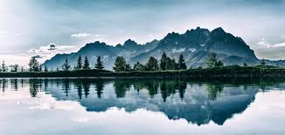
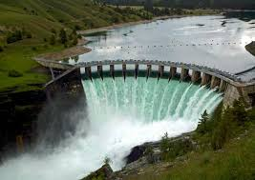
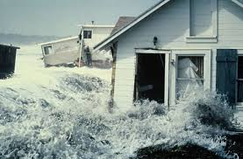
Water – The Definition
Water is a marvelous substance which can be beautiful, powerful and destructive

Slide 3
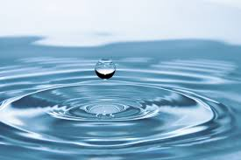
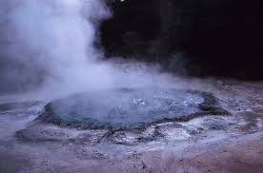
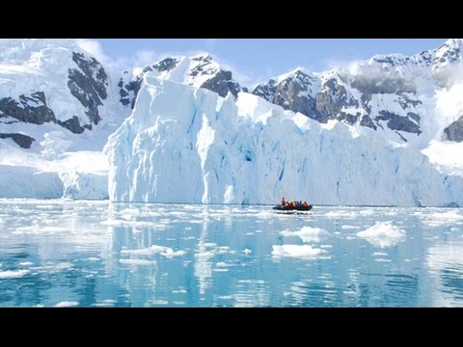
Water Physical Attributes Water is found in three states
Liquid
Solid
Gas

Slide 4
About Water
About 71 percent of the Earth's surface is water-covered
97% of the water on the Earth is salt water. However, only 3% percent is fresh water; slightly over 2/3 of this is frozen in glaciers and polar ice caps.
The remaining unfrozen freshwater is found mainly as groundwater, with only a small fraction present above ground or in the air.

Slide 5

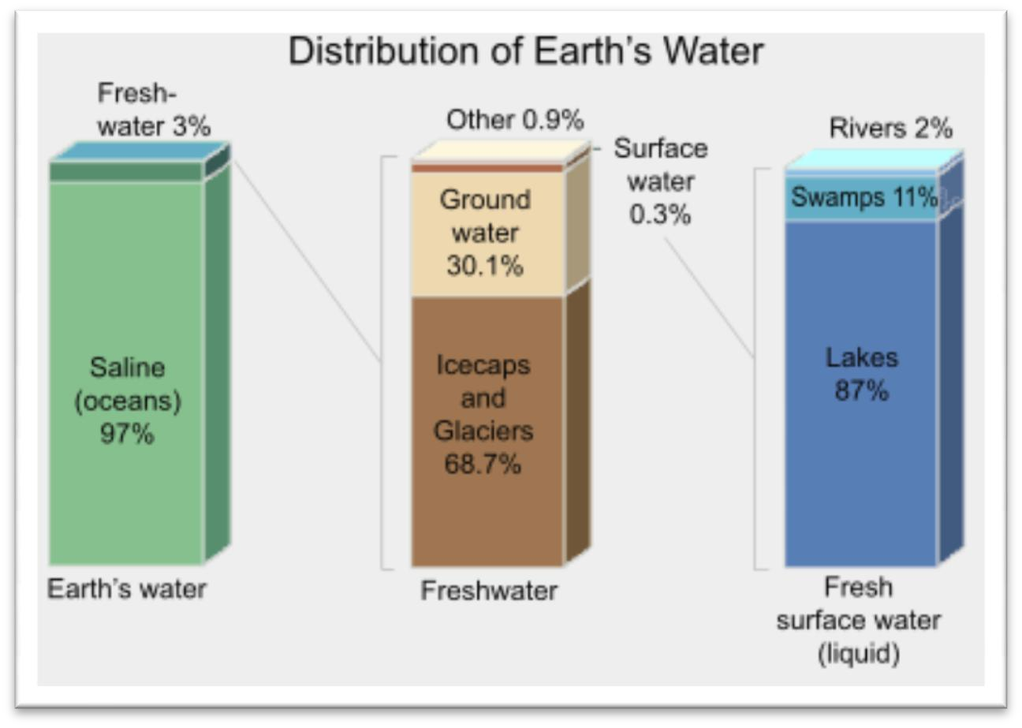
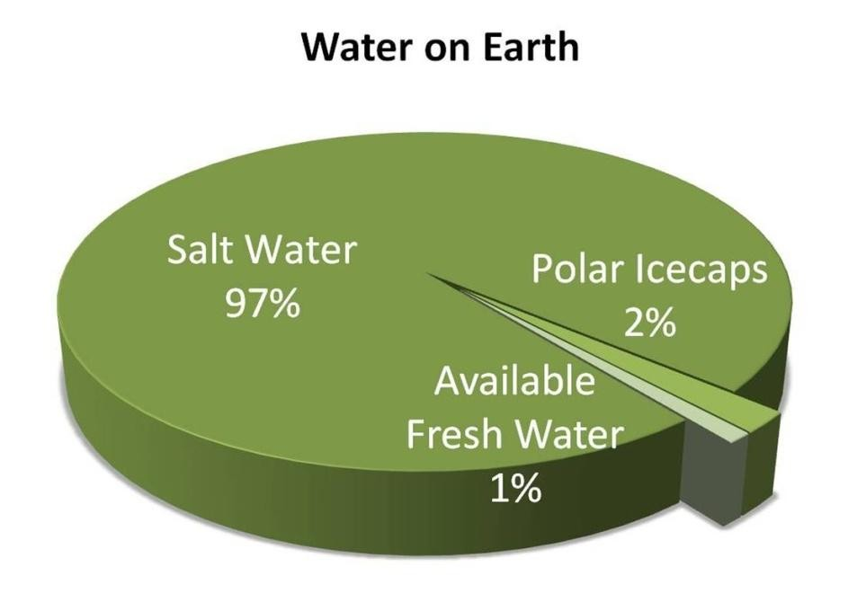
Water Forms and Distribution
A graphical distribution of the locations of water on Earth
This is how the water is distribute on Earth. If you could see here that is most amount of water in the oceans.

Slide 6
Volume of water stored in the water cycle's reservoirs
Reservoir | Volume of water (10⁶ km³) | Percent of total
Ocean | 1370 | 97.25
Ice caps & glaciers | 29 | 2.05
Groundwater | 9.5 | 0.68
Lakes | 0.125 | 0.01
Soil Moisture | 0.065 | 0.005
Atmosphere | 0.013 | 0.001
Streams & rivers | 0.0017 | 0.0001
Biosphere | 0.0006 | 0.00004

Slide 7
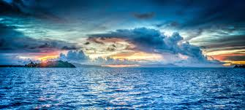
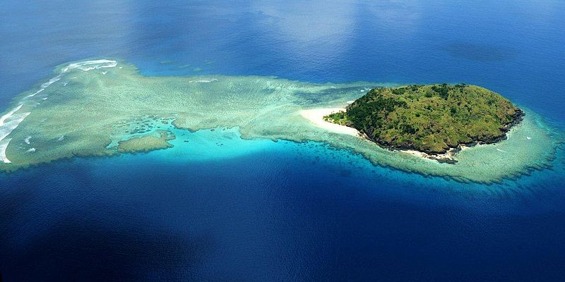
Oceans
Is the largest area and volume of water.
Contain more than 97% of the earth’s water.
Contain an average of 35g salt per liter.
Can be used after being desalinated

Slide 8
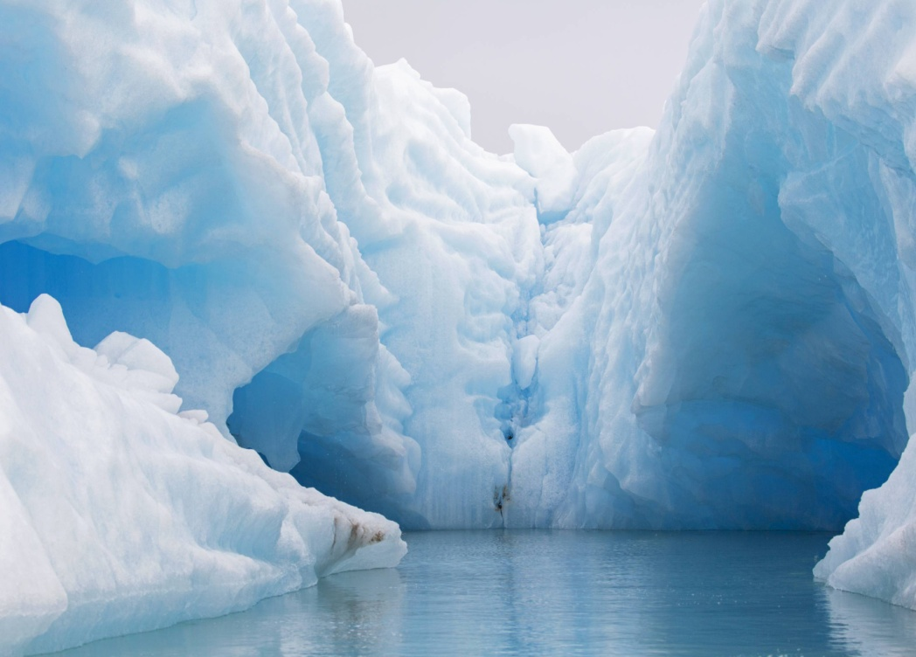
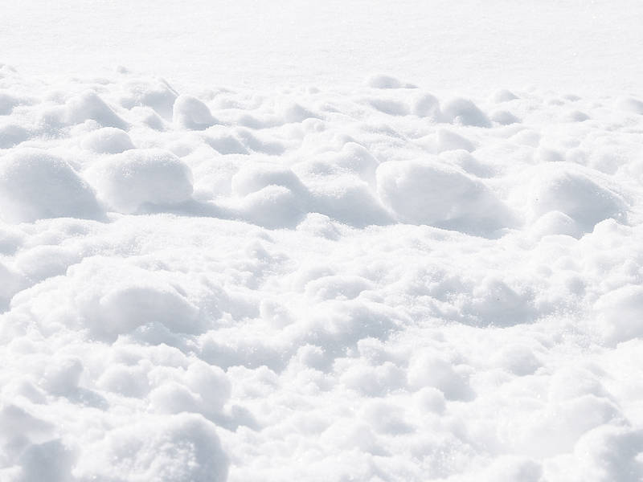
Ice and Snow
Contain almost 90% of freshwater.
Is as much as 2km thick.
Situated mostly in Antarctica (85%), Greenland (10%), and other snow mountain (5%)

Slide 9
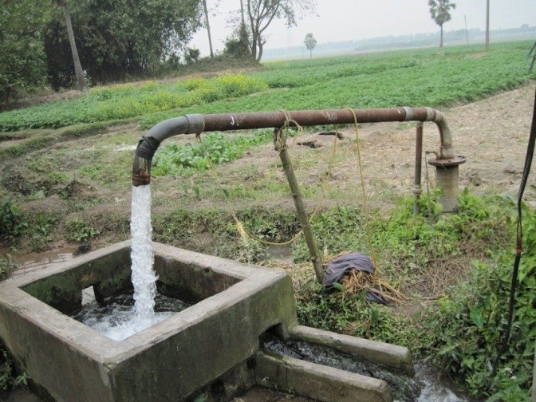
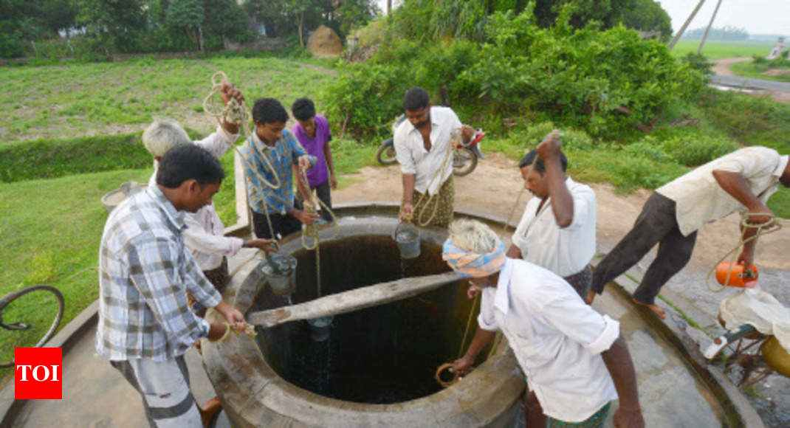
Groundwater
Groundwater is water in the rock and soil layer beneath Earth’s surface.
Absorb excess runoff rain and snow on ground.
Is readily available for use and drinking

Slide 10
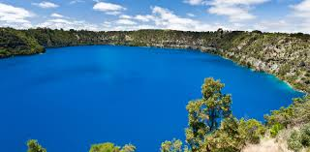
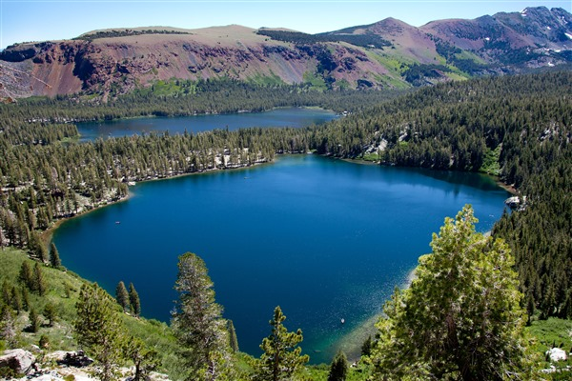
Lakes
Lakes are created from variety of geological events:
Tectonic-basin lake
Volcanic lake
Glacial lake
Groundwater-discharge lake
Lakes generate water from:
Collection of water in low
Areas
Natural or man-made dam(s)
Rivers and streams
Groundwater

Slide 11
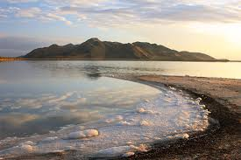
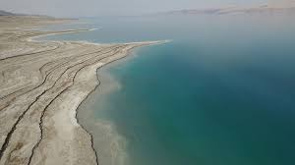
Lakes (cont.)
Saline lakes
Possess 85,000km³ (about 0.006% of total Earth’s water)
Saline lakes’ water cannot be used due to high salinity.
Major saline lakes: Caspian Sea (Central Asia),
The Great Salt Lake (U.S.),
The Dead Sea (between Jordan & Israel), and
Aral Sea (between Kazakhstan and Uzbekistan).
The Great Salt Lake
The Dead Sea

Slide 12
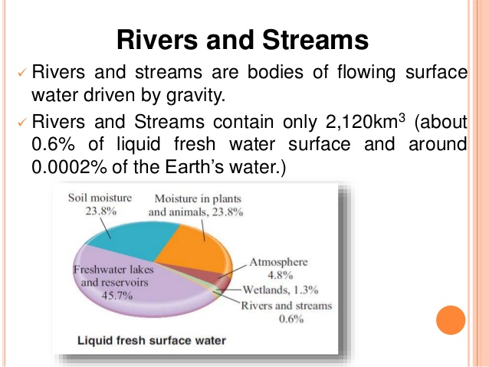

Slide 13
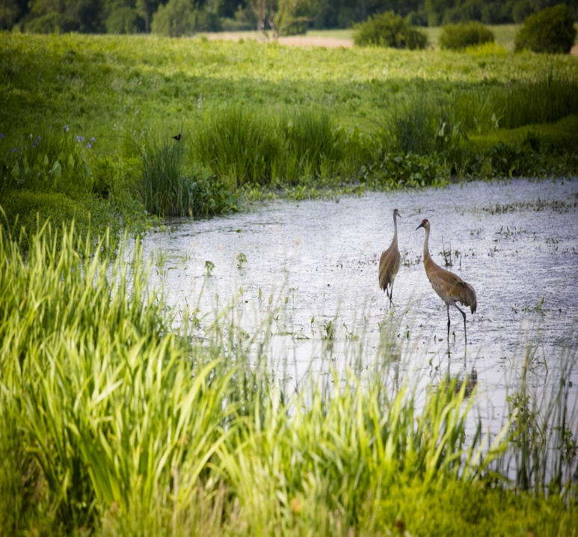
Wetlands and Soil Moisture
Wetland are areas of land where water covers the surface for at least part of the year.
They are not as important as lakes and rivers for water storage.
However, they play vital roles in:
Erosion protection
Flood reduction
Groundwater replenishment
Trapping nutrient and sediment
Water purification
Providing fish and wildlife habitat

Slide 14
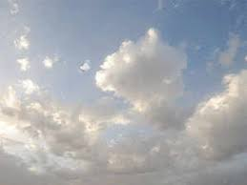
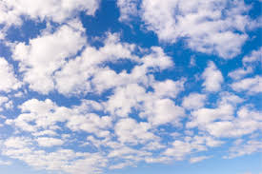
Atmosphere
Atmosphere contains about 0.001% of total Earth’s water.
It is around 4% of air volume in the atmosphere.
Movement of water through atmosphere provide mechanism for distributing freshwater to terrestrial reservoir (in form of rain, snow, hail…)

Slide 15
Types of Water Uses
Off-Stream Uses
Agriculture
Thermoelectric
Industrial
Mining
Domestic
Commercial
In-Stream Uses
Hydropower
Navigation
Recreation
Ecosystem Support

Slide 16
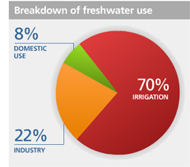
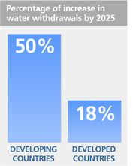
Types of Water Uses
Basic Assumption (by UN Water)
Source: World Water Assessment Agriculture Program (WWAP)
Source: Food and Organization (FAO)

Slide 17
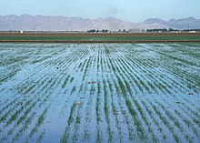
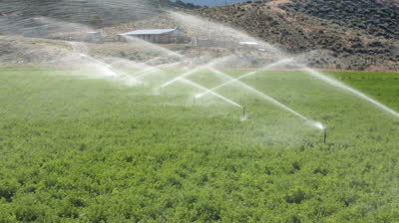
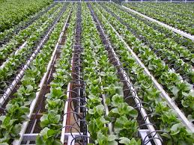
Off-Stream Uses: Agriculture
Irrigation
Crop irrigation consume 2/3 of water withdrawal.
Evaporation and seepage from unlined irrigation systems are the principal water losses.
There are three types of irrigation systems
Flood Irrigation
Sprinkler Irrigation
Drip Irrigation

Slide 18
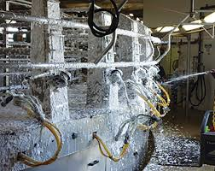
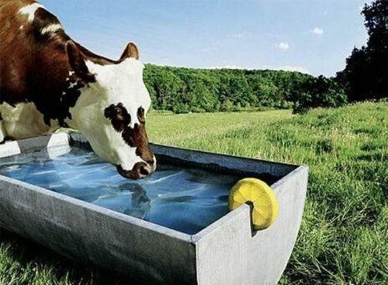
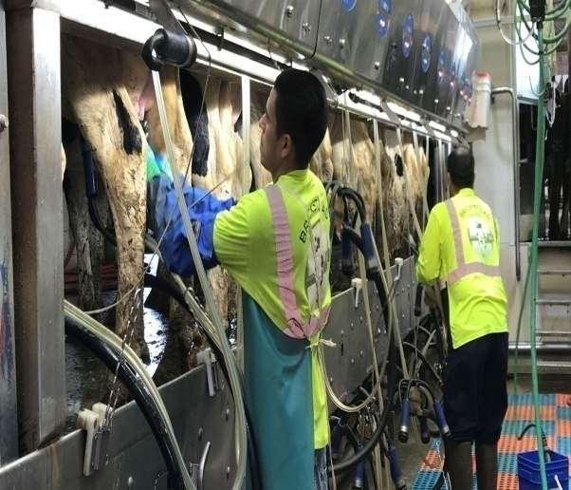
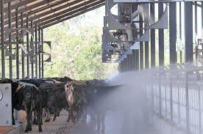
Agriculture
Livestock
Watering livestock
Dairy operation
Cooling livestock facilities
Dairy sanitation and clean-up
Animal waste disposal

Slide 19
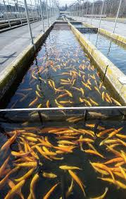
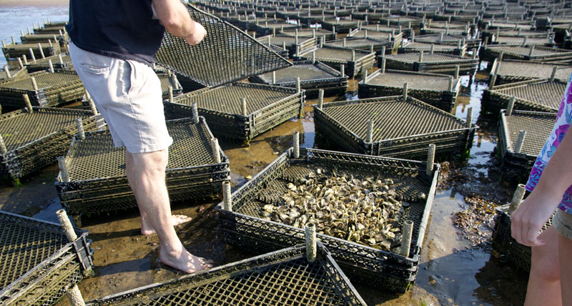
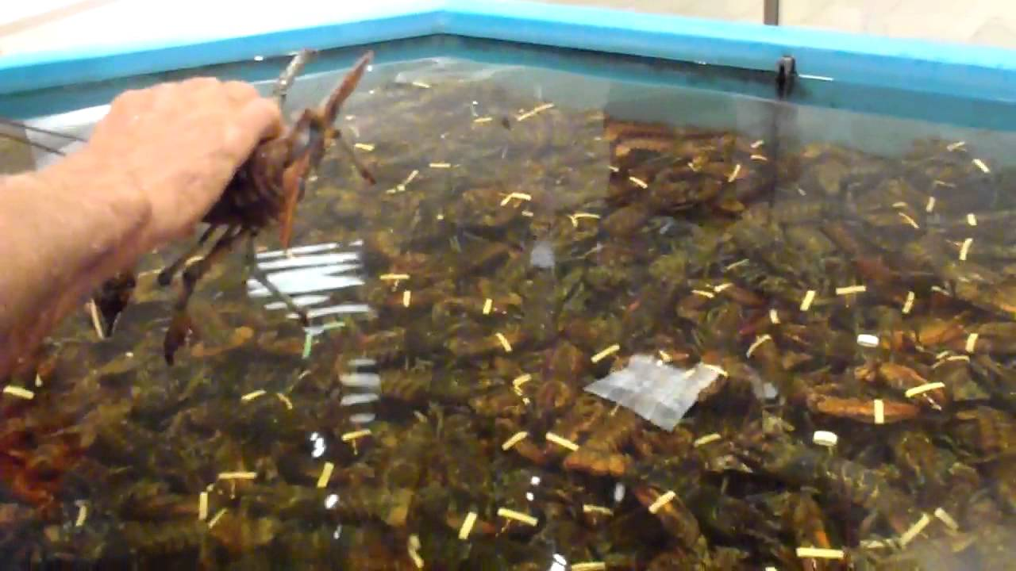
Agriculture (cont.)
Aquaculture
Raising fish.
Raising shellfish.
Raising shrimp and lobster.
Raising other creatures living in water

Slide 20
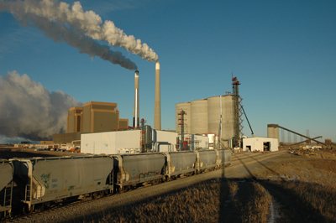
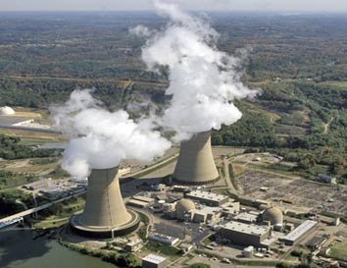
Thermoelectric
Water is used in production of electrical power.
Thermoelectric is one of the largest uses of water in U.S.
In 2005, it consumed about 201,000 million gallons of water each day.
Thermoelectric occupied 49% of total water use in U.S.
Both freshwater and saline water are used in thermoelectric

Slide 21
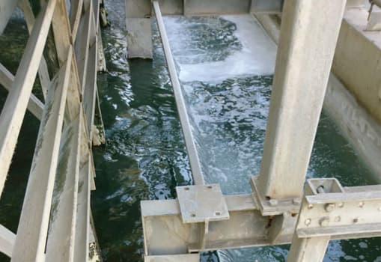
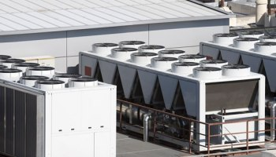
Industrial
Industries need water to cool down their machinery to a temperature that allows the manufacturing process to keep going.
Water is also needed to clean machinery, products, and buildings.

Slide 22
Industrial
In U.S. industrial uses were 83% (15,000 gallons/day) surface water and 17% (3,110 gallons/day) groundwater.
In a rough estimation by Water Environment Partnership in Asia showed:
Major industry consumed: 1,000-2,000 m³/day
Large industry consumed: 100-500 m³/day
Medium & small industry: 50 m³/day

Slide 23
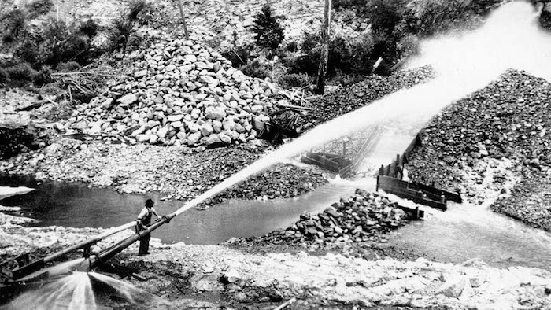
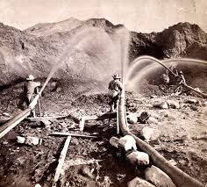
Mining
Water is used for the extraction of minerals that can be in forms of:
Solid: coal, iron, gold, sand – etc.
Liquid: crude oil.
Gas: natural gases

Slide 24
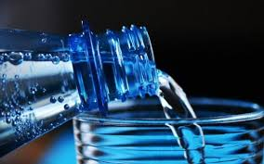
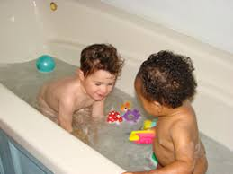
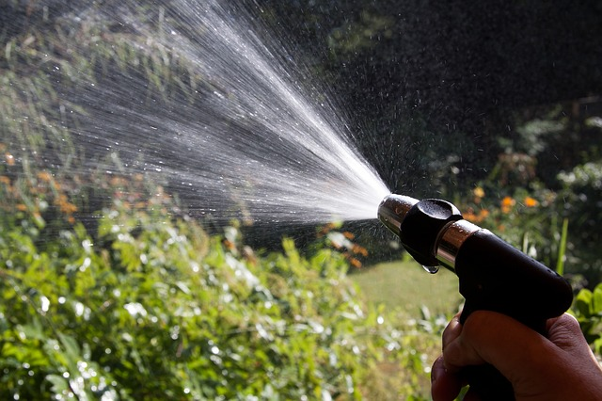
Domestic
Domestic water use is the consumption for household purposes – both indoor and outdoor
In Cambodia, domestic water use was around 136 million m³ (17% of total consumption)

Slide 25
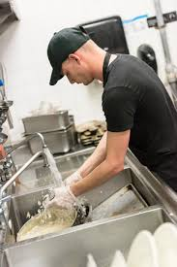

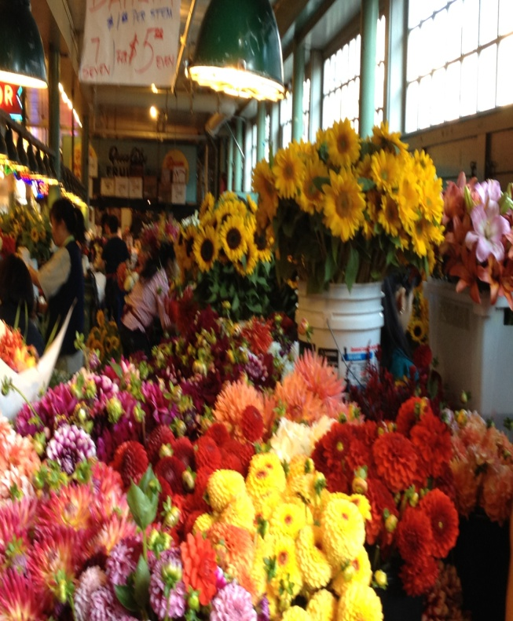
Commercial
Water is used in businesses such as hotels, restaurants, marketplaces, and so on.

Slide 26
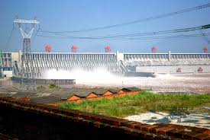
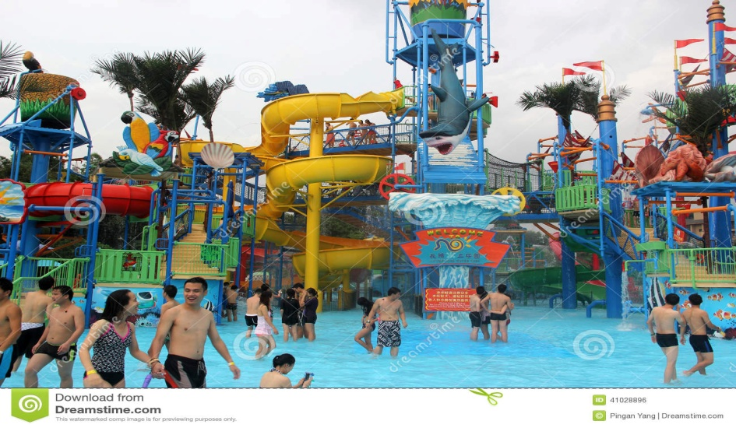
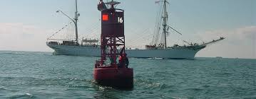
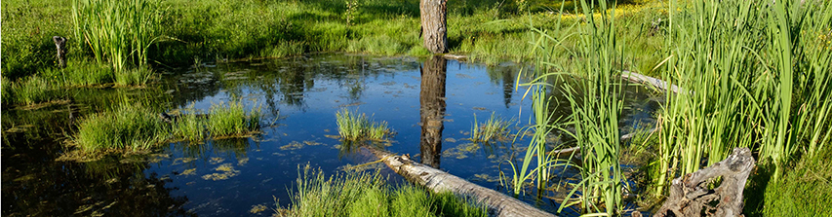
In-Stream Uses
Hydropower
Recreation
Navigation
Ecosystem Support

Slide 27
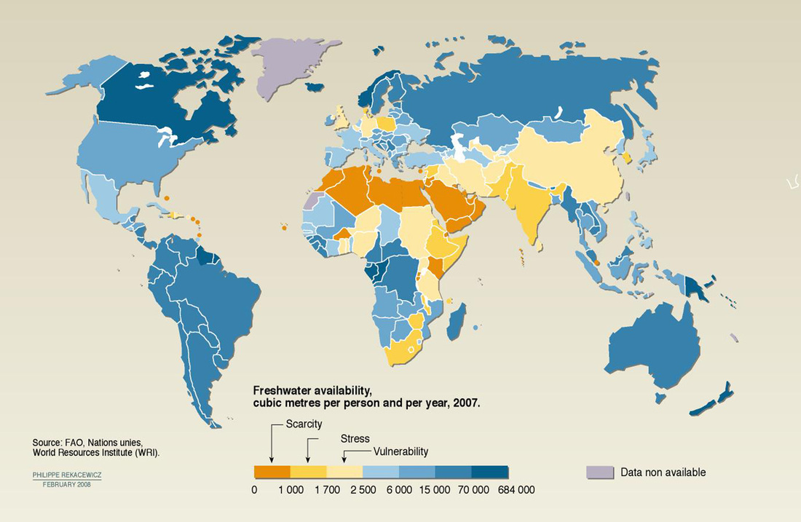
Earth’s Water

Slide 28



Water Stress & Water Scarcity
Water Stress:
Annual water supplies is less than 1,700 m³ per person.
Water Scarcity:
Annual water supplies is less than 1,000 m³ per person.
Absolute scarcity:
Annual water supplies is less than 500 m³ per person

Slide 29





Fresh Water Shortage
Fresh Water Shortage is due to:
Population growth
Lack of access to clean water
Groundwater is being depleted
Climate change / global warming
Rivers and lakes are shrinking

Slide 30
Water Use Problems and Conflicts
Water Overuse
Overuse in agriculture
Overuse in residence
Overuse in community
Control of Water Resources: where water supplies or access to water is at the root of tensions.
Military Tool: where water resources, or water systems themselves, are used by a nation or state as a weapon during a military action.

Slide 31
Water Use Problems and Conflicts
Political Tool: where water resources, or water systems themselves, are used by a nation, state, or non-state actor for a political goal.
Terrorism: where water resources, or water systems, are either targets or tools of violence or coercion by non-state actors.
Military Target: where water resource systems are targets of military actions by nations or states.
Development Disputes: where water resources or water systems are a major source of contention and dispute in the context of economic and social development

Slide 32
Increase Water Supply
Water Conservation
Development of groundwater
Desalinization
Developing salt-resistant crops
Developing drought-resistant crops
Rainmaking
Long distance water transport
Improve integration of water use

Slide 33

Solutions Sustainable Water Use
Not depleting aquifers
Preserving ecological health of aquatic systems
Preserving water quality
Integrated watershed management
Agreements among regions and countries sharing surface water resources
Outside party mediation of water disputes between nations
Marketing of water rights
Raising water prices
Wasting less water
Decreasing government subsides for supplying water
Increasing government subsides for reducing water waste
Slowing population growth
Notes:
Aquifers: Underground bed or layer yielding ground water for wells and springs etc

Slide 34
Conclusion & Recommendation
Water resources is EVERYONE’s concern!
The consumption has been increased significantly due to population growth.
Water availability is decreasing due to human overuse and natural degradation.
Many sources of water have become unusable.
Allegedly control over water lead to intraboundary and transboundary conflicts.
Effective water resource management and policy must be implemented on both local and international levels

Slide 35
Tips on How to Save Water
Increasing water resources start from all of us!
Don’t flush every time you use the toilet.
Take shorter showers
Don’t wash your car so often.
Don’t let the faucet run while washing hands, dishes, food, or brushing your teeth.
Don’t run the dishwasher when half full.
Dispose of used motor oil, household hazardous waste, batteries, etc., responsibly

Slide 36
Tips on How to Save Water
Don’t dump anything down a storm sewer that you wouldn’t want to drink.
Avoid using toxic or hazardous chemicals for simple cleaning or plumbing jobs.
If you have a lawn, use water sparingly. Water your grass and garden at night, not in the middle of the day.
Use water-conserving appliances: low-flow showers, low- flush toilets.
Check your toilet for leaks

Slide 37
THANK YOU ALL

